Slide 1
Tasks and Alerts
Emanuele Della Valle
Prof. @ Politecnico di Milano
Founder & Partner @ Quantia Consulting
Marco Balduini
Founder & CEO @ Quantia Consulting
Riccardo Tommasini
Prof. @ University of Tartu

Slide 2
Motivation

Slide 3
Data-driven decision
Descriptive
What happen?
historical
analysis
Diagnostic
Why did it happen?
Predictive
What will happen?
Data
Decision
Action
Decision Support
reactive decisions
Prescriptive
What should I do?
Decision Automation
[src. Gartner]
Machine-centered
Human-Centered

Slide 4
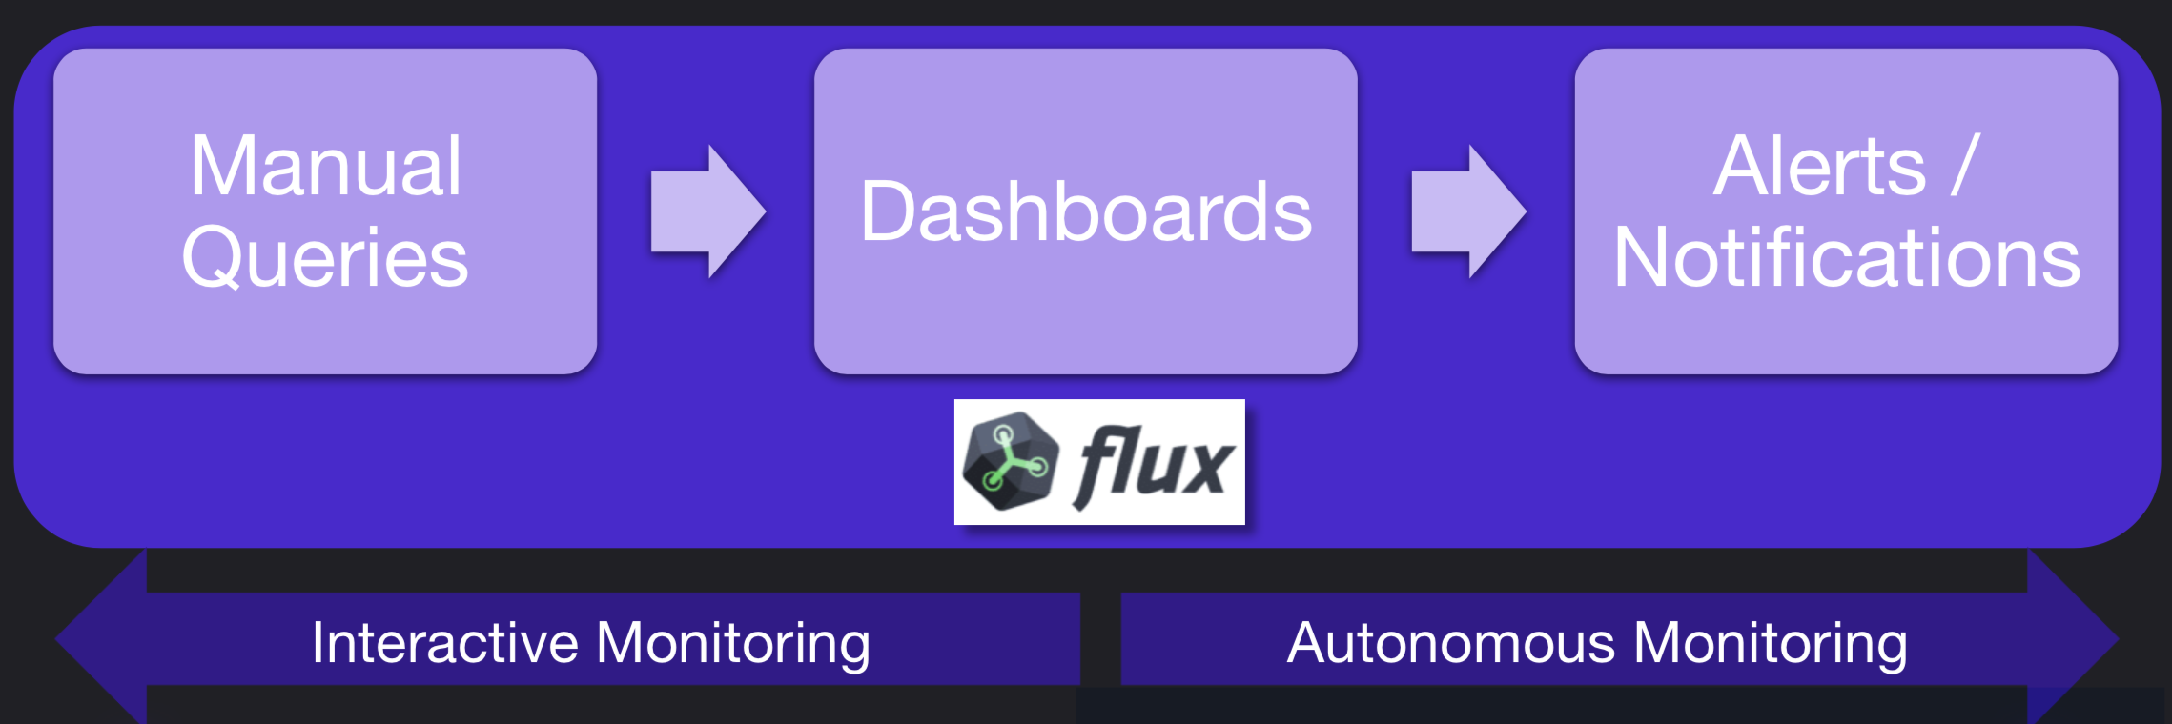
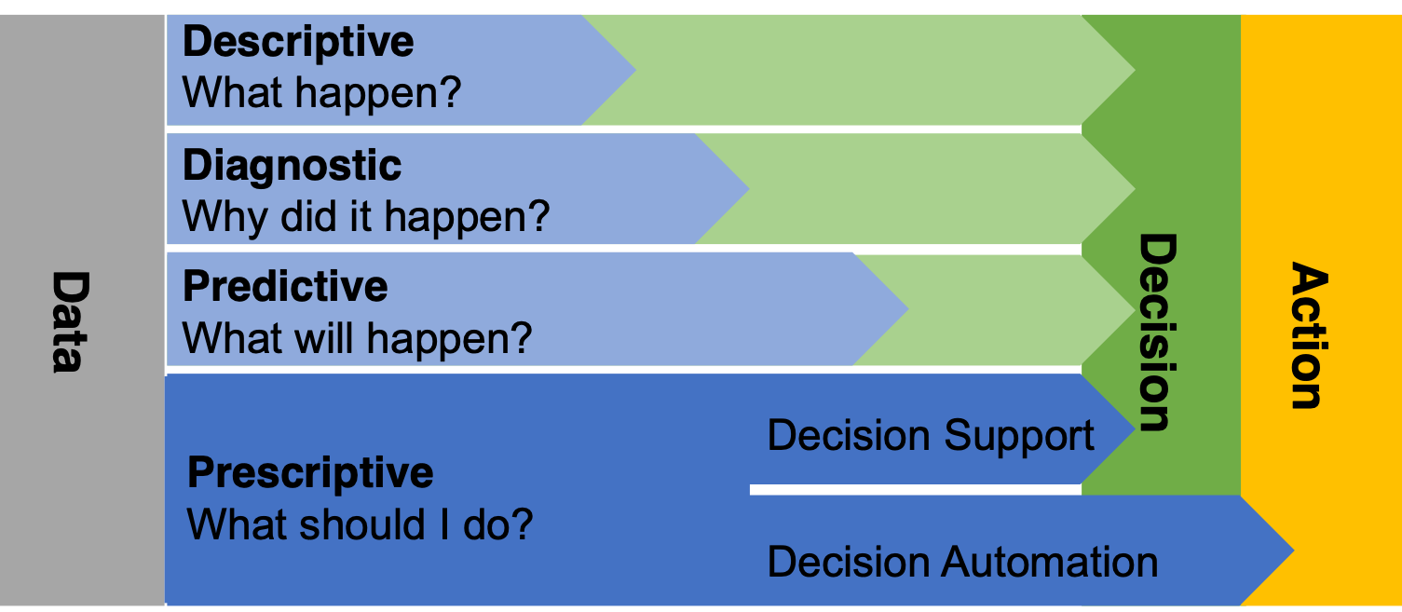
Interactive vs. Autonomous Monitoring

Slide 5

Recall
window
Data Sources
Registered Continuous Query
streams of answer
input streams
E. Della Valle

Slide 6
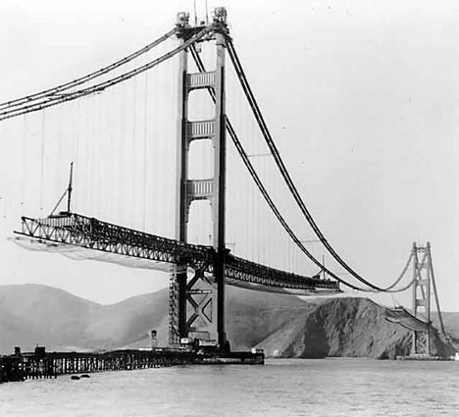
Interactive monitoring

Slide 7

Interactive monitoring vs. Continuous autonomous monitoring

Slide 8
Alerts

Slide 9

Anomalous Mozzarella Melting Temperature

Slide 10
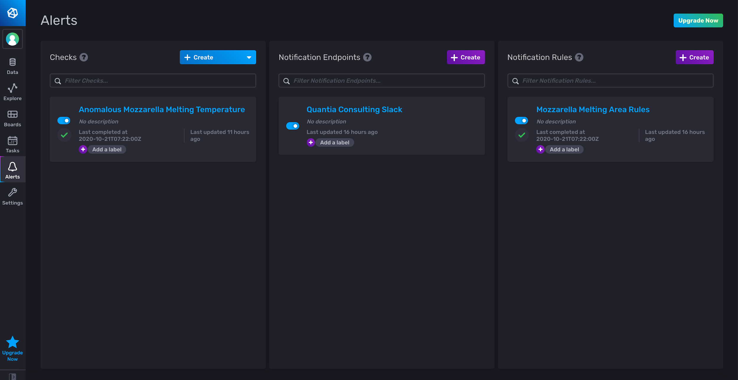
Alerts
Types of Alerts
Threshold
Deadman
Alerts are defined as
a base query
threshold criteria
condition mapping
notifications

Slide 11
Alert-UI

Slide 12
Alert-UI - Checks

Slide 13
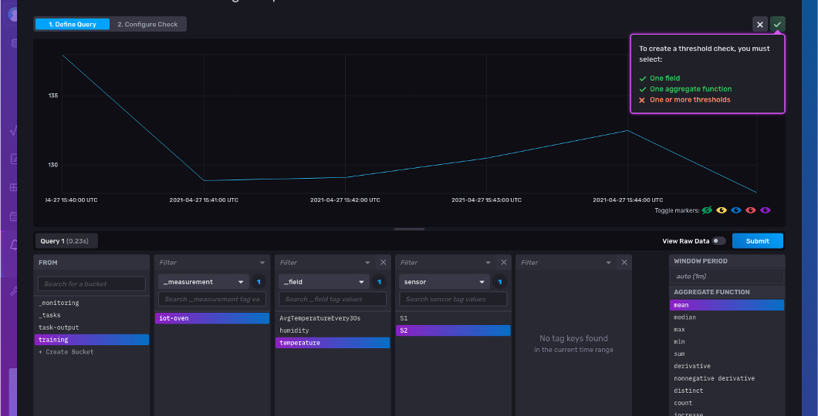
Alerts UI – check view – query pane
base query

Slide 14
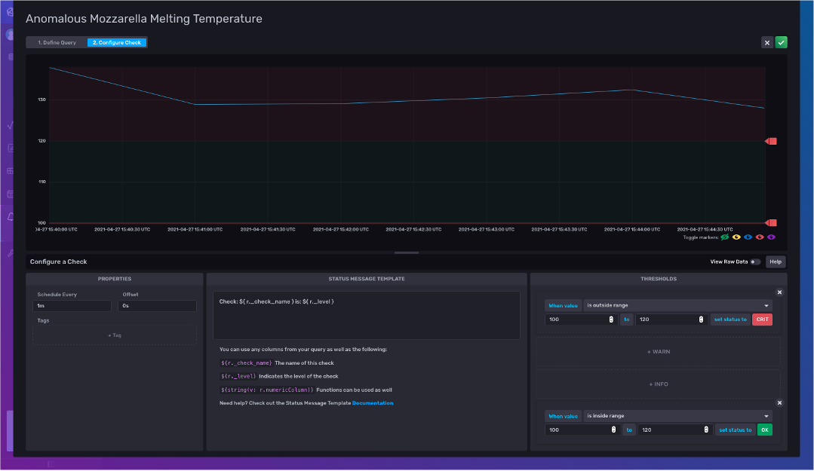
Alerts UI – check view – check pane
critic condition threshold
z-score > 3
warn condition threshold
z-score > 2
threshold criteria
condition mapping

Slide 15
Notifications
Possibility to define
Notification endpoints on a Slack channel

Slide 16
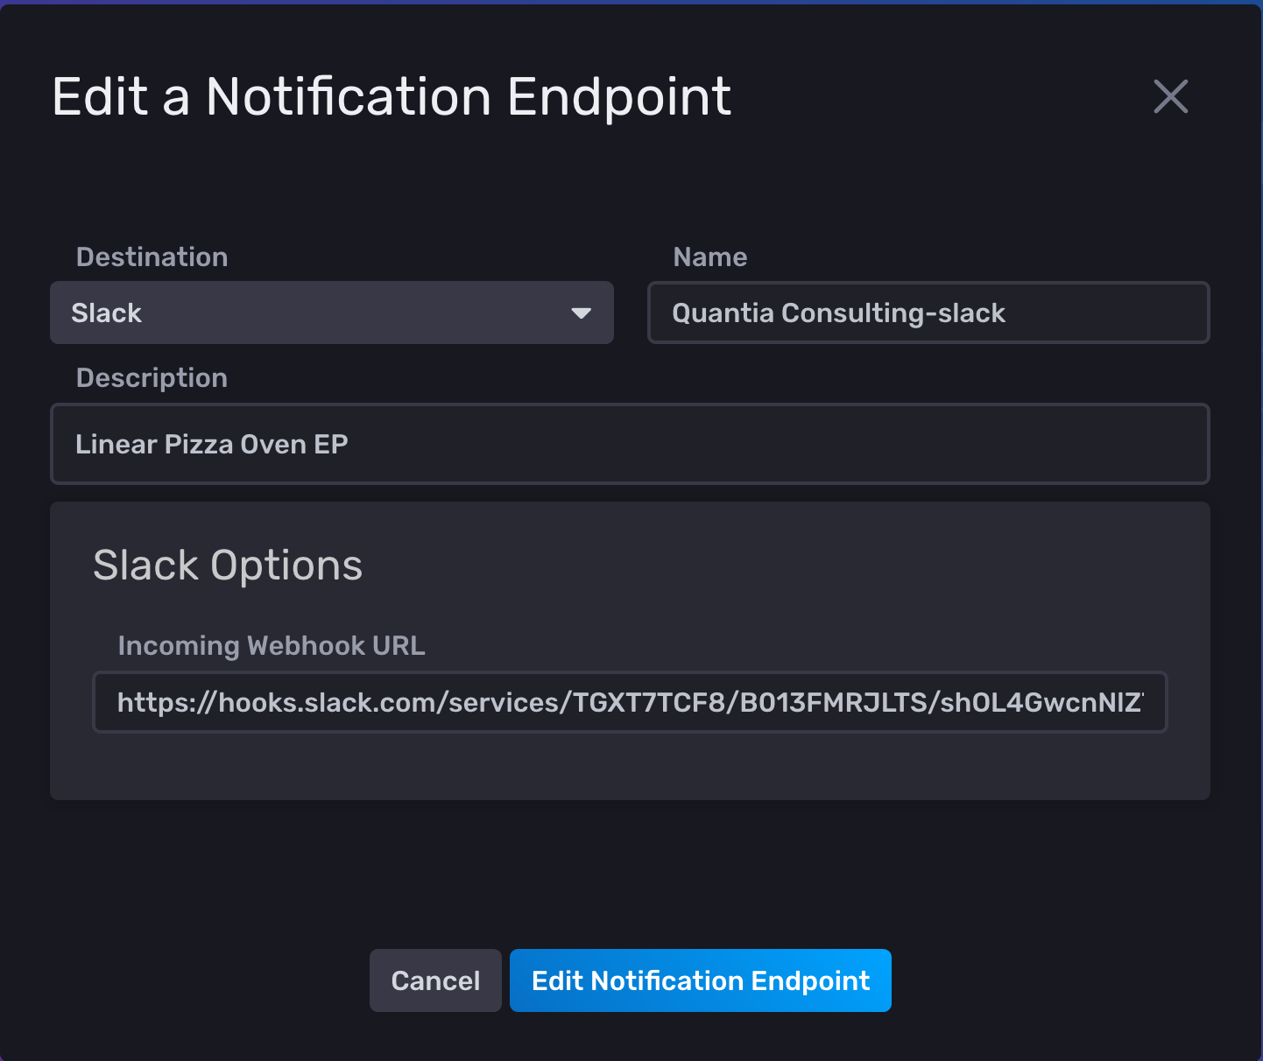
Notifications
Possibility to define
Notification endpoints on a Slack channel
Notification rules
When
What

Slide 17
Notifications
Possibility to define
Notification rules
When
What

Slide 18
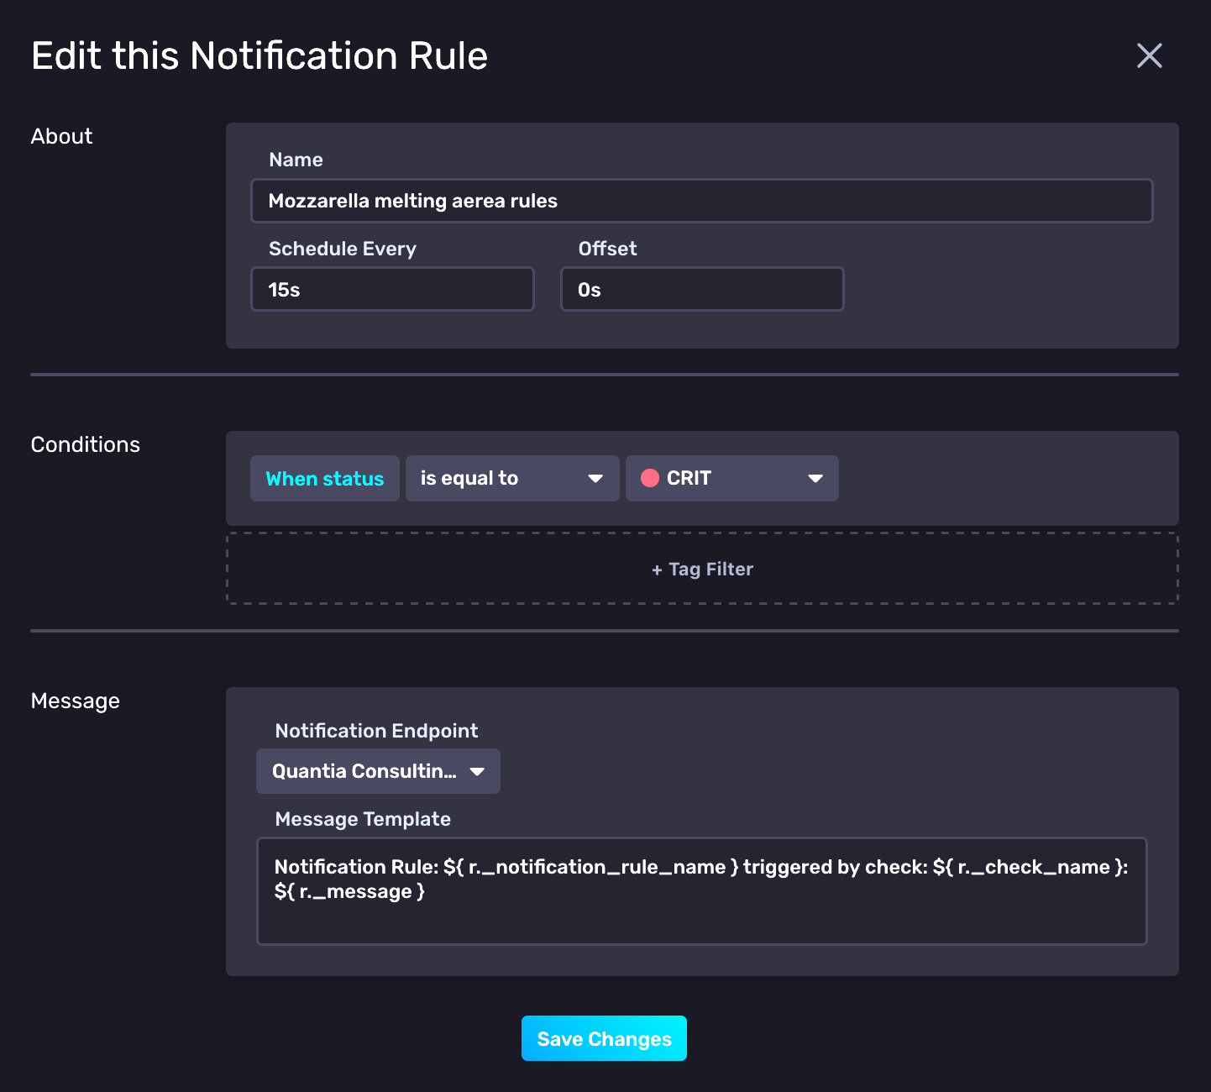
Notifications
Possibility to define
Notification rules
When
What

Slide 19
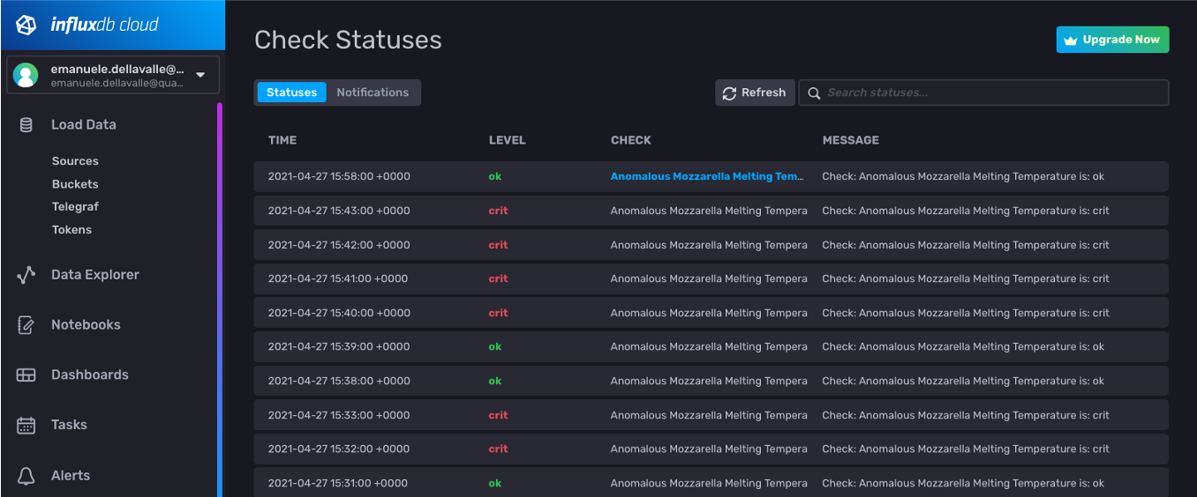
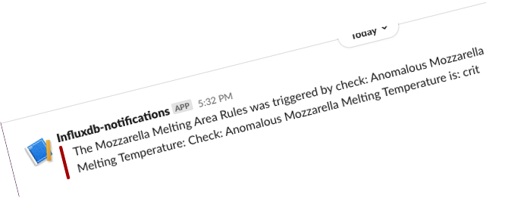
Alters history and notification on Slack

Slide 20
Tasks

Slide 21

The power of Flux for continuous processing and analysis

Slide 22
Tasks are Written in the Flux Language
No need to learn a separate language to write Tasks
No need to use separate tools for debugging Tasks
Tasks define all options within the script for portability
Options include
Name
Run Interval: every in CRON syntax
Tasks are self contained and can be imported / exported

Slide 23
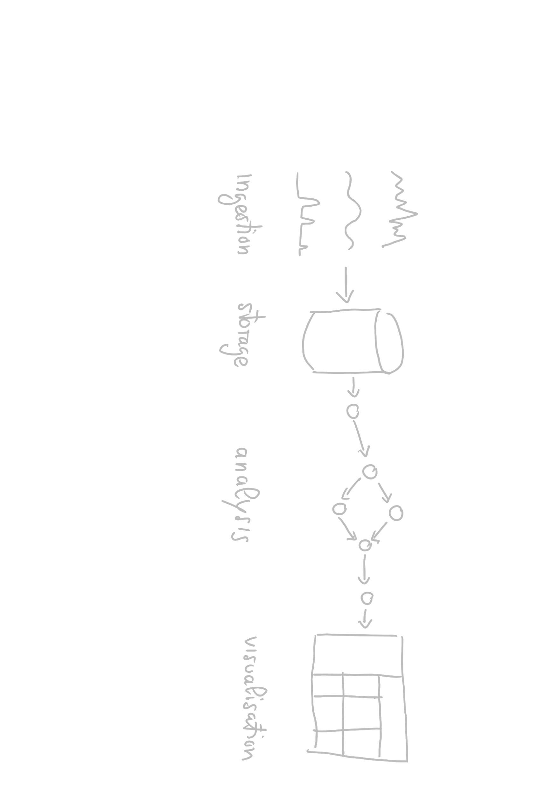
Recall the Data Lifecycle

Slide 24
Tasks continuously write back to the storage the results of the analysis

Slide 25
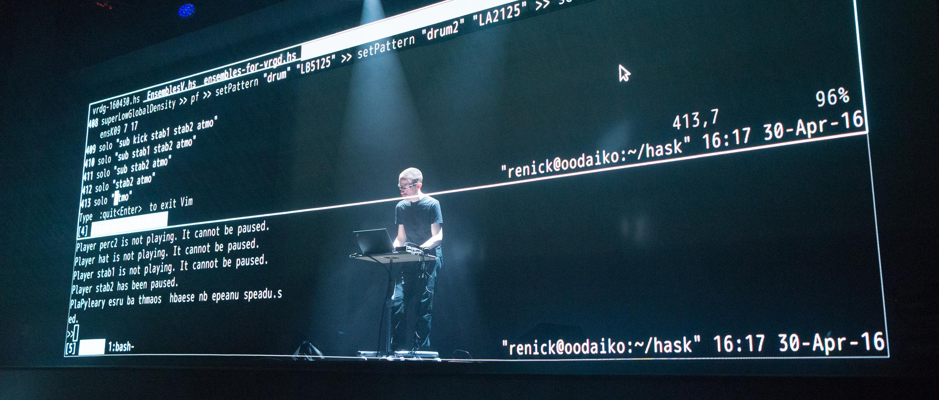
Let’s do some live coding

Slide 26
Here we go
from(bucket: "training")
|> range(start: -30s)
|> filter(fn: (r) => (r._measurement == "iot-oven"))
|> filter(fn: (r) => (r._field == "temperature"))
|> filter(fn: (r) => (r.sensor == "S1"))
|> mean()

Slide 27
Recall
range(start: -30s)
Data Sources
mean()
input streams
streams of answer
E. Della Valle

Slide 28
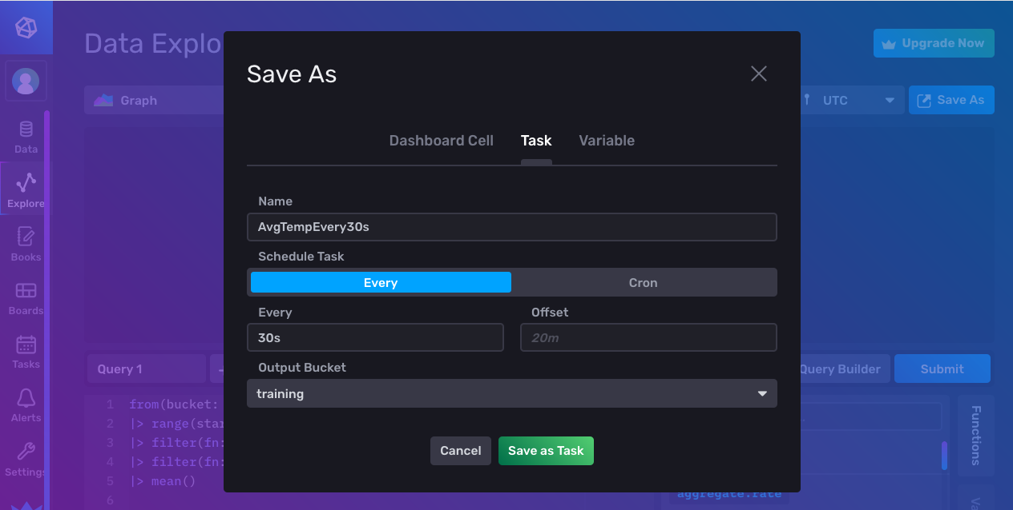
Let’s save it as a task …

Slide 29
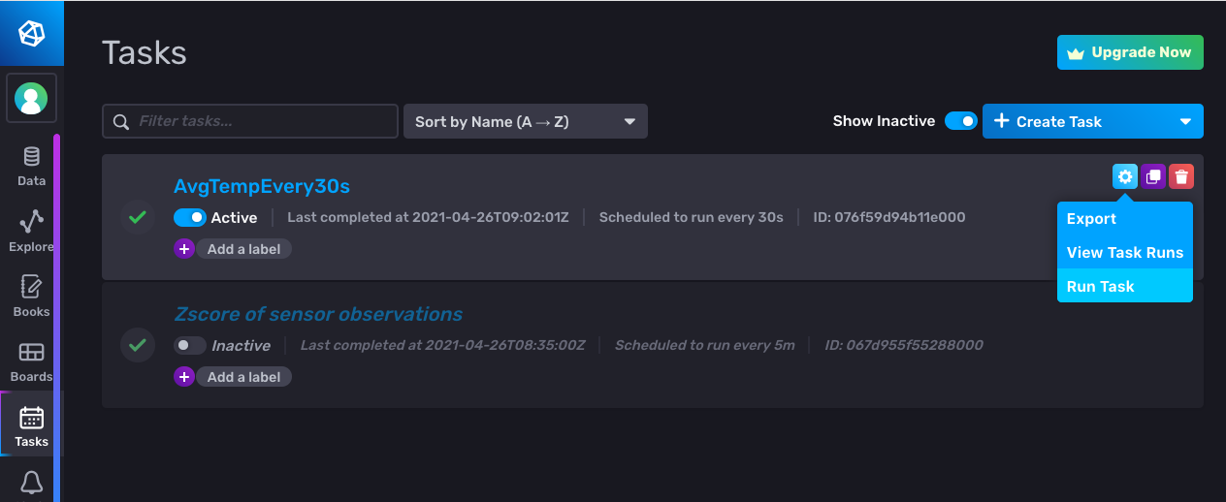
Here it is in the Task pane … let’s run it

Slide 30
It gives an error, why?
:-/

Slide 31
It’s not the missing to() … the UI added it for us
Syntax
to(bucket: <<name>>, org:<<organization>>)
Example
from(bucket:"foo")
|> ...
|> to(bucket: ”bar", org:”some@quantiaconsulting.com")

Slide 32
What are we missing?
The output data format does not comply with InfluxDB data model:
- _time is missing
Moreover, semantically, the name of the field is still the one of the original observation:
- We may want to rename it in AvgTemperatureEvery30s

Slide 33
Here we go :-)
from(bucket: "training")
|> range(start: -30s)
|> filter(fn: (r) => (r._measurement == "iot-oven"))
|> filter(fn: (r) => (r._field == "temperature"))
|> mean()
|> map(fn: (r) => ({r with _time: r._stop}))
|> map(fn: (r) => ({r with _field: "AvgTemperatureEvery30s"}))
|> to(bucket: "training", org: "…@quantiaconsulting.com")

Slide 34
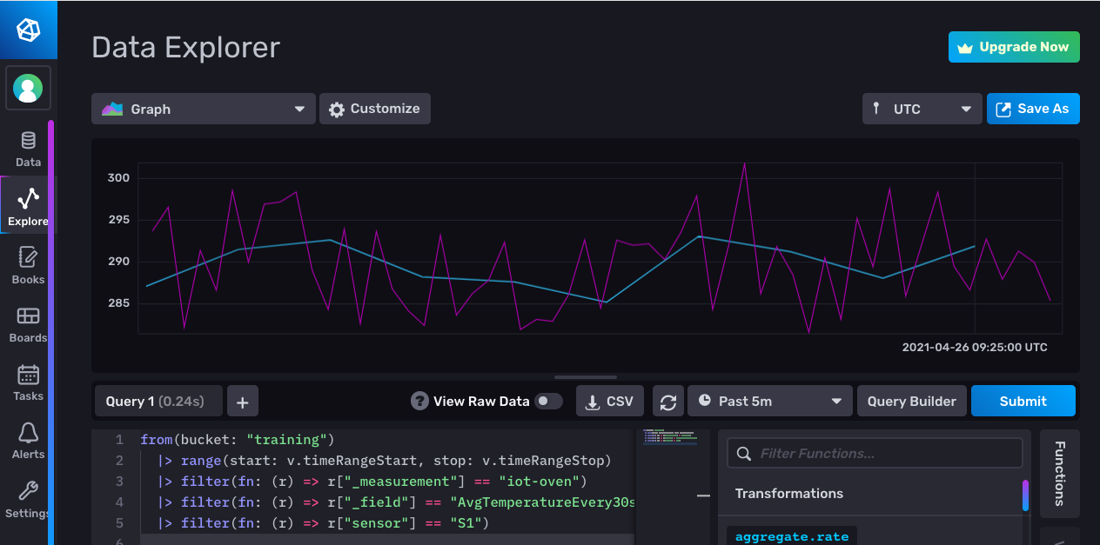
Let’s visualize the results

Slide 35
Tasks and Alerts
Emanuele Della Valle
Prof. @ Politecnico di Milano
Founder & Partner @ Quantia Consulting
Marco Balduini
Founder & CEO @ Quantia Consulting
Riccardo Tommasini
Prof. @ University of Tartu

